Slide 1
HOTEL RESERVATION ANALYSIS
Prepared By : Loice Nguku

Slide 2
INTRODUCTION
The data is from two hotels .
The data is clean with no duplicates or missing values.
The analysis was done using sql and tableau for vizualizations.
The task was to draw insights and compare the performance of the city hotels and resort hotels.

Slide 3
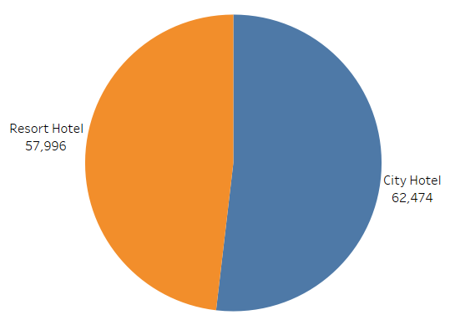
COUNT OF RESERVATION BY HOTEL

Slide 4
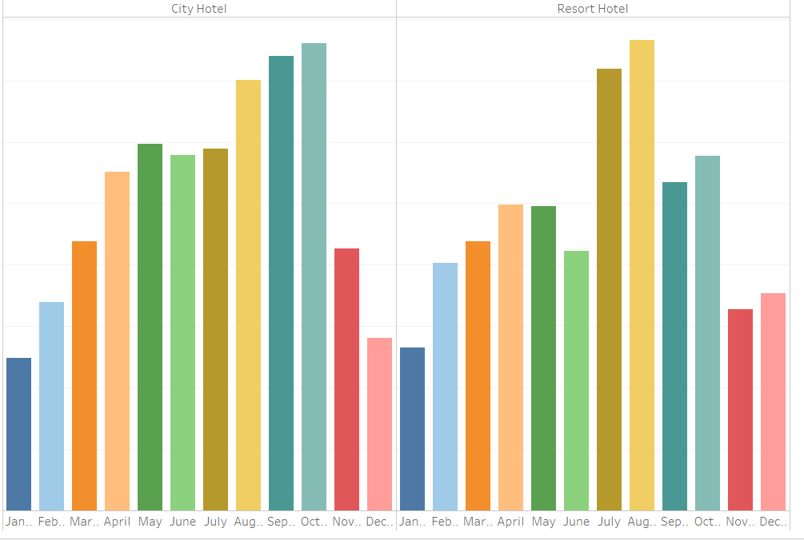
RESERVATION BY MONTH

Slide 5
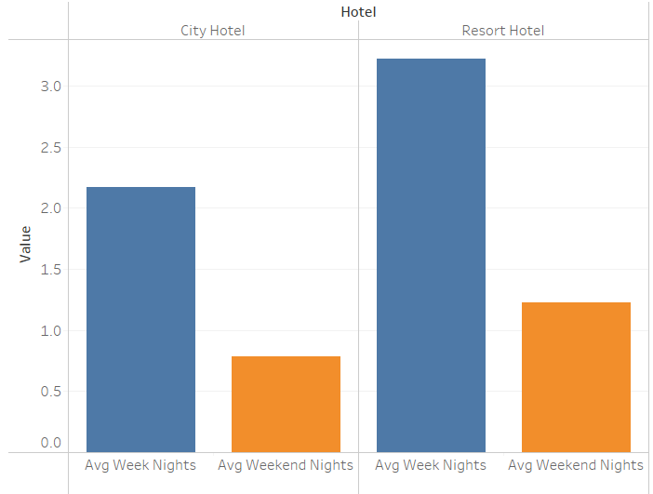
WEEKEND VS WEEKDAYS STAY-INS

Slide 6
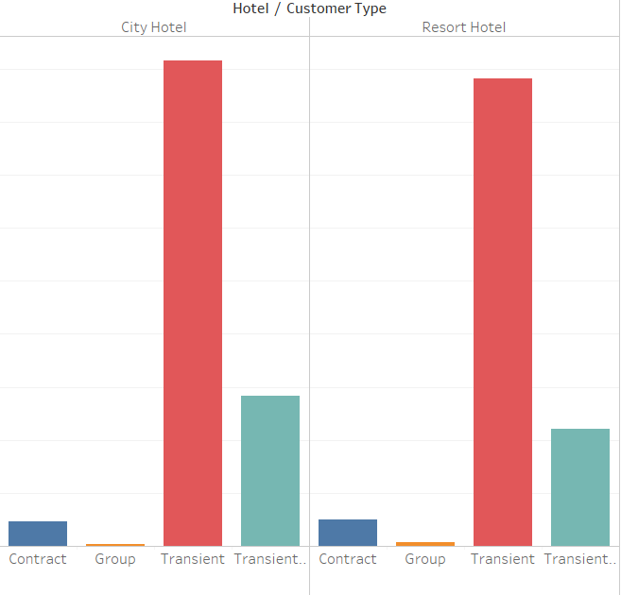
CUSTOMER TYPES

Slide 7
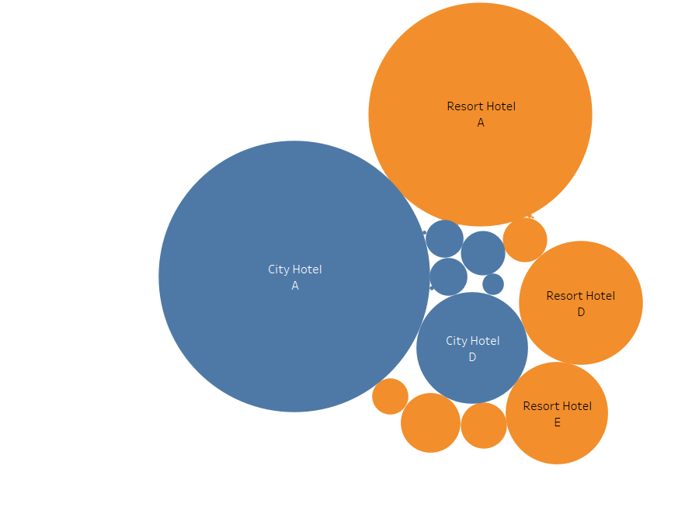
RESERVED ROOMS

Slide 8
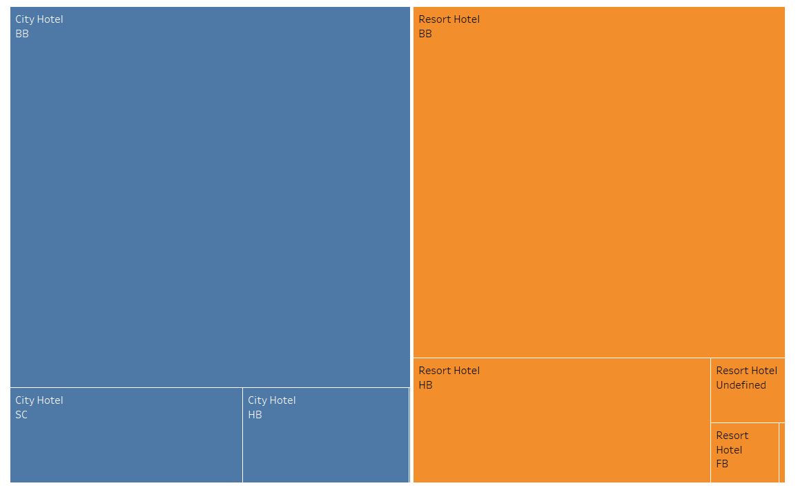
MEAL PREFERENCES

Slide 9
OBSERVATIONS
The city hotels are performing better than Resort hotels on all indicators from count of available reservations to low cancellations.

Slide 10
RECOMMENDATIONS
There is a lot of effort needed for the resort hotels.

